Slide 1
Name:- Yash Rajendra Gaikwad
Data Analytics Trainee
Project 2:- Instagram User Analytics
Software Used:- My SQL Workbench 8.0 CE
TASK:-
A) Marketing Analysis:-
1) Loyal User Reward.
2) Inactive User Engagement.
3) Contest Winner Declaration.
4) Hashtag Research.
5) Ad Campaign Launch.
B) Investor Metrics:-
1) User Engagement.
2) Bots And Fake Accounts.

Slide 2
A) Marketing Analysis
1) Loyal User Reward:- Identify the five oldest users on instagram from the provided database.
Process:-
First we Import the Database in to the MySQL.
Now we use the data from the users table by selecting the username and created_at columns.
Then we use the order by function so, we get order of the desired output by sorting it with the created_at column in ascending order.
lastly we use the limit function, so that we will get only top 5 oldest Instagram users as a output.

Slide 3
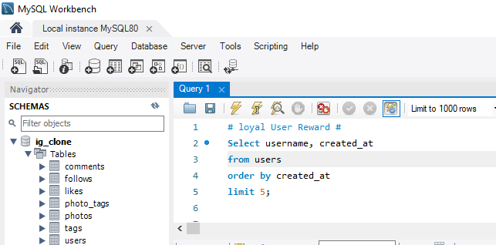
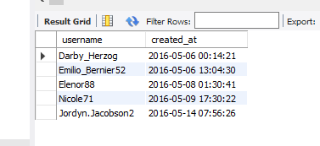
Query
Result:- Finaly, we get the Top 5 Most Loyal Instagram users.

Slide 4
2) Inactive Users Engagement:- Identify the users who have never posted a single photo on Instagram.
Process:-
We will first select username, users.id and user_id column from the users table.
Then we will left join photos table on the users table, on users.id = photos.user_id.
We use it because, both the users.id and photos.user_id have common contents in them.
Then we will find rows from the users table where the photos.id is null.
Lastly we use order by usier.id function and we will gwt the users who have never posted a single photo on Instagram.

Slide 5
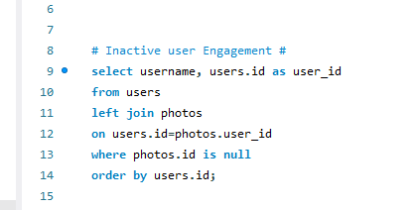
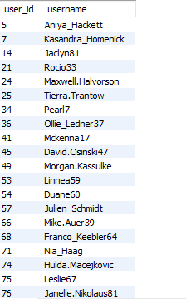
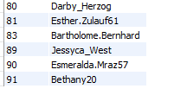
Query:-
Result:- There are total 26 Instagram users who have never posted a single photo on Instagram.

Slide 6
3) Contest Winner Declaration:- Determine the winner of the contest and provide their details to the team.
Process:-
First we will select the users.id as user_id, users.username, photos.id as photo_id, photos.image_url and count(*) as total from photo.
2. Then, we will use the inner join the three tables wiz : photos, likes and users, on likes.photo_id = photos.id and photos.user_id = users.id.
3. Then, we use the group by function so we will get the output on the basis of photos.id
4. After that we use order by function so we will get the data on the basis of the total in descending order
5. Finaly, we will using limit function to view only the top liked photo’s information

Slide 7
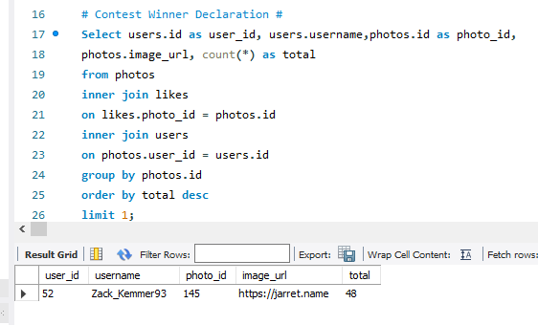
Query And Result:- After Analysis, we find that Zack_Kemmer93 is winner of Contest.

Slide 8
4) Hashtag Research:- Identify and suggest the top five most commonly used hashtags on the platform.
Process:-
To find the top 5 most commonly used hashtags on Instagram first we need to select the tag_name column from the tag table.
We use the count(*) as total_number_of_times_tag_used_individually so as to count the number of tags used individually.
Then, we use the join function for tags table and photo_tags table, on tags.id = photo_tags.tag_id cause they contain the same content in them i.e. tag_id
After that we use group by function to get the desired output on the basis of tags.tag_name
Then using the order by function we need to sort the output on the basis of total(total number of tags per tag_name) in descending order
Finally, to find the top 5 most used tag names we will use the limit 5 function.

Slide 9
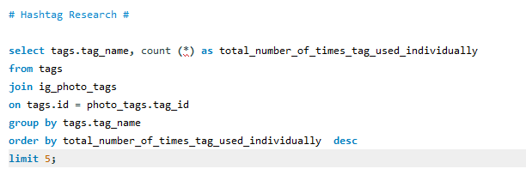
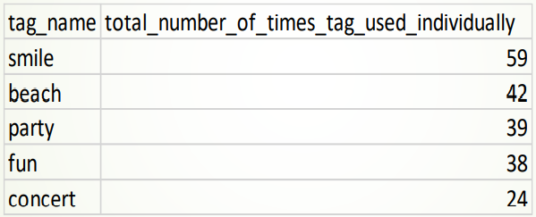
Query:-
Result:- After anakysis we find that the Smile is the most used Hashtag followed by beach, party, fun, concert.

Slide 10
5) Ad Campaign Launch:- Determine the day of the week when most users register on instagram. Provide insights on when to schedule an ad campaing.
Process:-
To launch the Ad Campaign we have to find the day of week on which most users register on Instagram.
First we need to define the columns of the desired output table using select dayname(created_at) as day_of_week.
Same we use for the count(*) as total_number_of_users_registered from the users table
Then we use the group by function so we get the output table on the basis of day_of_week.
Lastly we use the order by function we sort the output table on the basis of total_number_of_users_registered in descending order.

Slide 11
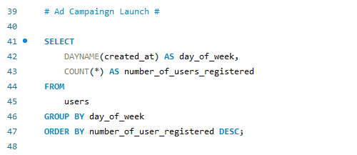
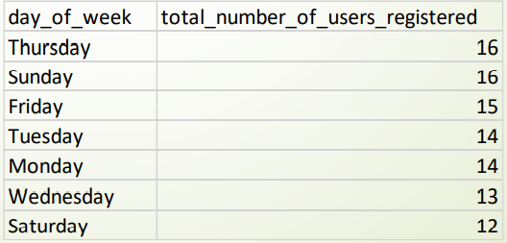
Query:-
Result:- After the analysis we find that most of the users registered on Thursday and Snday. So, it would beneficial to start Ad on Thursday and Saturday,

Slide 12
B) Investor Metrics
1) User Engagement:- Calculate the average number of posts per user on instagram. Also, provide the total number of photos on instagram divided by the total number of users.
Process:-
In this we need to perform two operations
First Case
First, we need to find first the count number of photos(posts) that are present in the photos.id column of the photos table i.e. count(*) from photos.
Similarly, we need to find the number of users that are present in the users.id column of the users table i.e. count(*) from users.
We divide both the values count(*) from photos/count(*) from users and hence we would get the total number of photos / total number of users.
Lastly how many times the users posts on Instagram we need to find the total occurrences of each user_id in photos table

Slide 13
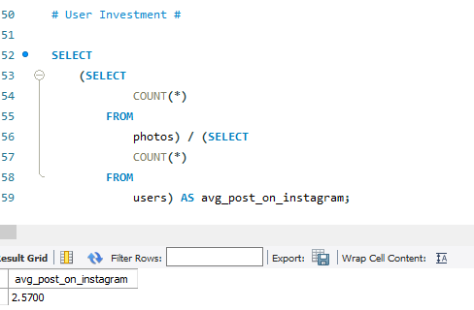
Quary And Result For First Case:- After the analysis we found out that the average user posts around 2.57 times on the Instagram.

Slide 14
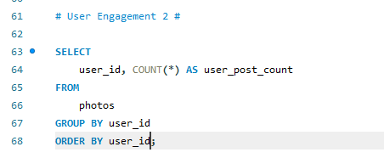
Second Case
In second case we need to find the total number of photos on Instagram OR the total number of users.
First we Select the user_id also we use the count(*) function to find the number of photos on Instagram OR the total number of users and name it as user_post_count from the photos
Then, we use the group by function to get the output table according to the user_id.
Lastly, we use the order by function to sort the output tabe by user_id
Query:-

Slide 15
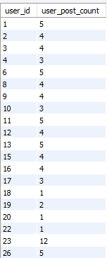
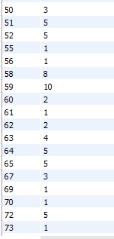
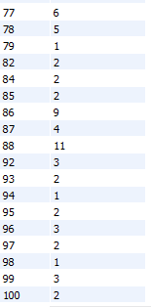
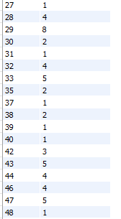
Result:- This is the list of Total number of photos on instagram OR the total number of users on Instagram.

Slide 16
2) Bot And Fake Accounts:- Identify users (potential bots) who have liked every single photo on the site, as this is not typically possible for a normal user.
Process:-
To find the bots and fake accounts First, we select the user_id column from the photos table and the username column from the users table
Then, we use the count(*) function to count the total number of likes from the likes table.
After that we use the inner join function on users and likes table on the basis of users.id and likes.user_id.
Now we use the group by function so that we get the output table on the basis of likes.user_id.
Lastly, we search for the values from the cout(*) from photos having equal values with the total_likes_per_user.

Slide 17
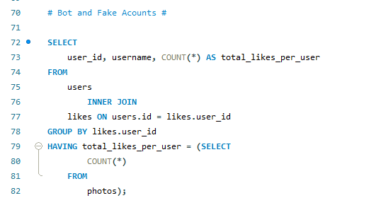
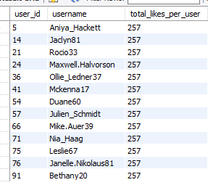
Query:-
Result:- After analysis we find the Bots and Fake acounts.

Slide 18
END

